Slide 1
Big Mountain Resort
By Allie Wicklund

Slide 2
Table of Contents
Problem Identification
Recommendation and Key Findings
Modeling Results and Analysis
Summary and Final Recommendation

Slide 3
Problem Identification
“By enacting Scenario 2 and raising weekend ticket prices by $X, will Big Mountain Resort be able to pay for the increased operational costs this season?”

Slide 4
Scenario 2
Add a new run
Add a new chairlift
Increase maximum vertical drop by 150 feet

Slide 5
Problem Identification
How much is X?
New chairlift was purchased last season
Estimated additional seasonal cost: $1,540,000

Slide 6
Recommendations and Key Findings
Price increase of $1.99 justified by Scenario 2’s upgrades
Earns BMR additional $3,474,638 this season*
*Assuming 5 average tickets per customer and 350,000 customers

Slide 7
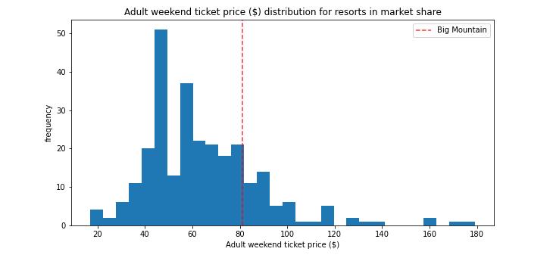
Modeling Results and Analysis

Slide 8
Modeling Results and Analysis
Used Random Forest model for analysis
Model suggests $95.87 price for adult weekend ticket
May be off in either direction by $10.39

Slide 9
Modeling Results and Analysis
$83 ticket is below estimates for model
Model does not account for operational costs
Model performed better than linear model (R squared)

Slide 10
Summary and Final Recommendation
Enact Scenario 2
Raise Adult Weekend ticket prices to $83
These will pay for both the new chairlift from last season and Scenario 2

